Slide 1
Celebrating 35 years of Ministry!
Pastor Mark was ordained on July 4, 1982 at Epiphany Lutheran Church, Dayton, Ohio, by Dr. Jim Chiles.
He had served five congregations before coming to Emanuel. Pastor Mark was Installed as Emanuel's Associate Pastor on May 8, 2005, and on December 13, 2009
he was Installed as our Senior Pastor.
We are so proud of your ministry and happy that God Called you to Emanuel to serve as our pastor! Congratulations on 35 years of ministry!

Slide 2
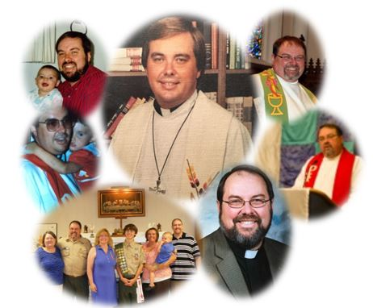
Congratulations Pastor Mark!

